Slide 1

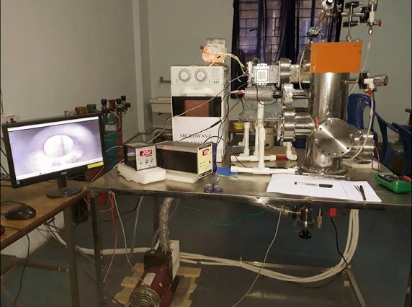
Annealing Study of Copper Foil
Towards Grain Size Optimization
By
Aditya Mukherjee &
Arpan Dutta
Under the guidance of
Dr. G. S. Taki,
Samit Karmakar &
Soumik Kr. Kundu
Applied Materials Research Laboratory
Img src: https://sites.google.com/view/iem-amrl/facilities
March 2020

Slide 2
OBJECTIVE: Improve the grain size of the crystal orientations in a polycrystalline Copper foil (80um)
EXPERIMENT: The polycrystalline Copper film was annealed at two different temperatures (550°C, 640°C) in a vacuum sealed chamber (~50e-3 mbar) for different time intervals (30 min, 45 min, 60 min).
ONGOING WORK:
Crystallographic structure of the Treated films are being characterized by XRD method.
Results from the XRD analysis will provide us the required data to estimate the grain size of annealed Copper.
FUTURE APPLICATION: Further these films are to be used for synthesis of graphene film.

Slide 3
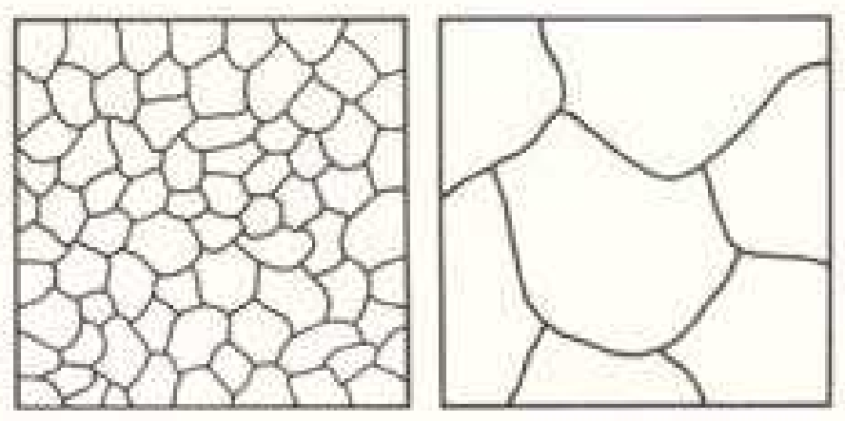
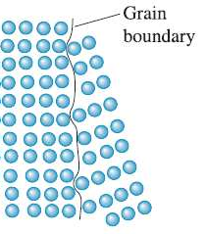
Dependence of Grain Size on Annealing
The term annealing refers to a heat treatment in which a material is exposed to an elevated temperature for an extended time period and then slowly cooled.
STAGES OF ANNEALING:
1. heating to the desired temperature.
2. holding at that temperature.
3. Comparatively slow cooling, usually to room temperature.
Before After
A grain is a bunch of crystals arranged in a specific orientation. A polycrystalline structure is formed by multiple grains
After recrystallization is complete, the strain-free grains will continue to grow if the metal specimen is left at the elevated temperature

